Slide 1
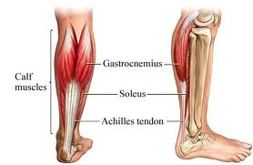
Time to abandon the Tendinitis myth
Dr. Danica Bonello Spiteri
MD MRCP(UK) Dip SEM (Bath)
Registrar in Sports & Exercise Medicine, Leeds, UK

Slide 2
Tendinopathy…..
How does it happen?
mechanical stresses on the tendon with repetitive loading
Impingement of the tendon between adjacent structures (bones, ligaments) and impaired blood supply

Slide 3


Causes
House Painting cartoon 1 - search ID ctsn155
Intrinsic Factors
Extrinsic Factors
Age – ‘mature’ tissues heal less efficiently
Chronic disease – diabetes, rheumatoid arthritis, connective tissue disease
Biomechanics – adverse mechanical stress
Repetitive activity in work, sport or leisure
Often a sudden burst of DIY activities (gardening, painting,refurbishing)
Sport – an increase in training load

Slide 4
Presentation
Pain is linked to activity, but also present at rest
Pain felt after activity or during prolonged activity, thus reduces performance at work
In early stages, pain eases off with ‘warm up’
Symptoms return later, limiting activity
Weakness and loss of function of affected part
Occasionally tendon rupture ensues (Achilles)

Slide 5
Assessment
Often little to see, sometimes slight swelling
Tender to touch
Reduced ROM limited by tightness in muscle
Pain on impingement of the affected tendon

Slide 6
Imaging
Not usually required to make diagnosis
Used to exclude other pathology
Ultrasound – preferred option
Partial tears are quite a common finding, even in asymptomatic tendons
Occur more often in older adults

Slide 7
Old thinking
Tendinitis
Inflammatory condition
Anti-inflammatory treatments
Steroid injections
?surgery

Slide 8
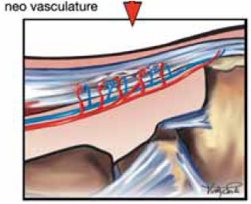
Pathology
Tendon histopathology: there is no inflammatory change in symptomatic tendons
Pathological process is mucoid degeneration with inadequate repair and remodelling.
Loss of tightly bundled collagen structure and increased proteoglycan ground substance in tendon
Evidence of neovascularisation, with growth of nerve fibres into tendon

Slide 9
Why is there pain?
Pain is due to neovascularisation and neural growth
Irritation of mechanoreceptors by vibration, traction or shear forces, which trigger nociceptive receptors by neurotransmitters such as substance P and by biomecanical irritants such as chondroitin sulphate.
Modern treatments aim to reverse the neovascularisation and encourage healing and remodelling

Slide 10
New thinking
Tendinopathy
Degenerative condition
Inadequate healing
Neovascularisation of the tendon
Treatments to accelerate healing
To reduce neovascularisation
NSAIDS not appropriate
Slow recovery – may take months

Slide 11
Treatments
Initial presentation if acute (up to 4weeks)
  Ice
  Acupuncture
  Rest
  No evidence to support use of NSAIDS

Slide 12
Treatment
In chronic cases > 4weeks
No evidence to support use of NSAIDS
Steroid injections may provide short to medium term pain relief, but no long term benefits
Steroids have a role in treating any associated bursitis
Physiotherapy with an eccentric loading programme has greater long term benefits

Slide 13
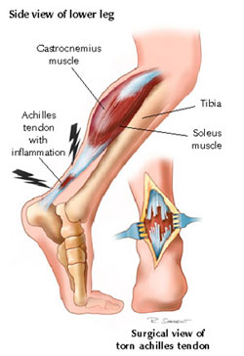
Treatment
Electrotherapies (ultrasound, extracorporeal shock wave treatment and laser) have no good evidence to support it
Orthotic devices – no good evidence
Acute tendon ruptures – urgent referral to orthopaedic surgeon, unless it is the long head of biceps tear, where function is usually maintained by intact short head of biceps

Slide 14
Novel treatment
Eccentric Progressive Loading treatment (EPL)
  Exercises are painful
  Encourage patient to exercise into the pain
  Exercises less effective if not painful
  Must be continued for months
  Gradual increase in the loading of the tendon
  Done twice daily with three sets of 15 each.
  Recovery is slow, thus manage patients’ expectations carefully!

Slide 15
Further treatments
Sclerosant injections
GTN patch over affected tendon
Injection of autologous blood or platelet rich plasma
(but limited evidence for these!)

Slide 16
However….
Many patients will still gets better by spontaneous resolution of the pain over time, rather than healing of the pathology

Slide 17
What is the aim of treatment?
Resolution of pain?
Return to normal function? (Also includes sporting activities!)
Healing of the pathology?
Not all the above refer to the same outcome.
Effective treatments may only get rid of the neovascularisation, without proper healing of the pathology. This is still under review.

Slide 18
Final Message
The key factor is that treatment options must ensure that
  Pain is alleviated
  Allows return to normal function
  Does NO harm
We know that
  NSAIDS can cause substantial harm, including death!
  Steroid injections have a poorer long term outcomes than physiotherapy referral

Slide 19
Ashcroft surgery

Slide 20
Thank you!
Questions??

